Slide 1

1 Corinthians 15:57: “But thanks be to God, who gives us the victory through our Lord Jesus Christ

Slide 2
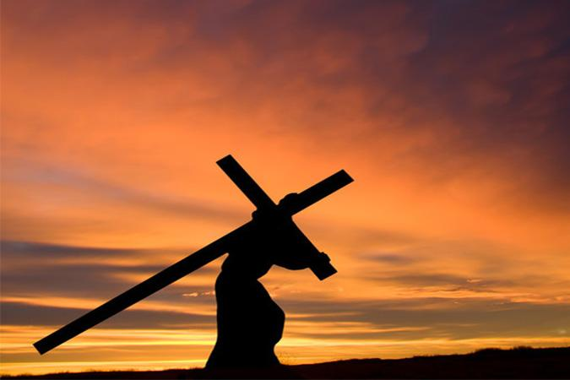
Title: Victory in the Life of Christ

Slide 3

1. Overcoming Sin
Romans 8:37 – “No, in all these things we are more than conquerors through him who loved us.”

Slide 4
2. Victory Over Trials
John 16:33 – “In this world, you will have trouble. But take heart! I have overcome the world.

Slide 5
3. Victory over Death
1 Corinthians 15:55-57 ESV - “O death, where is your victory? O death, where is your sting?” The sting of death is sin, and the power of sin is the law. But thanks be to God, who gives us the victory through our Lord Jesus Christ.

Slide 6
4. Living in Victory
2 Corinthians 2:14 – “But thanks be to God, who always leads us as captives in Christ’s triumphal procession and uses us to spread the aroma of the knowledge of him everywhere.”

